Slide 1




CHILD’S NAME
Your family story
Insert photo of the child

Slide 2

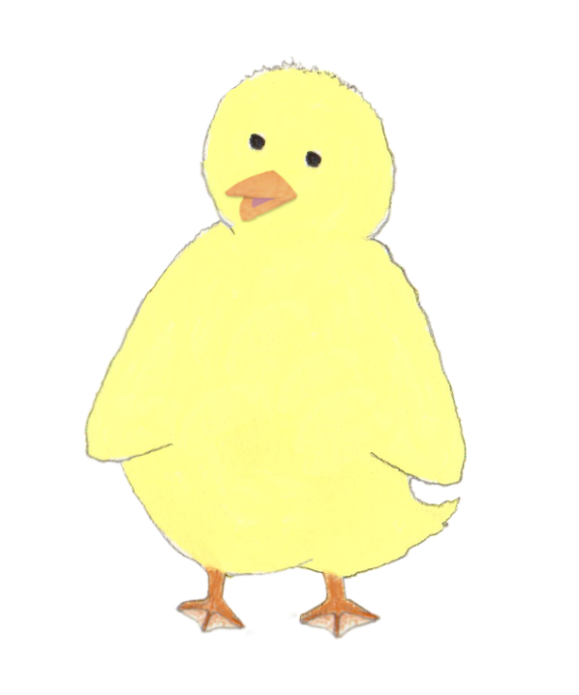
Wonderful You
Insert photo
of the child
Insert some text about the child’s personality, including lots of positives, for example:
You are a fun, busy child, with a lot of energy and a great sense of humour! You enjoy playing board games with your parents and going on picnics with your grandparents. Your favourite foods are xyz and you are a brilliant dancer! You are kind and you like to help Mummy plant things in the garden.

Slide 3
Your family
Edit as applicable to the child’s adoptive family. List all immediate family members and anyone heavily involved in their lives. Pets can be included too.
Your family is Mummy, Daddy, and you!
You also have grandparents, aunties, uncles and cousins.
Everyone in your family loves you very much and feels very lucky to have you in their life.
This book talks about how and why you became part of your family.
Insert family photo

Slide 4
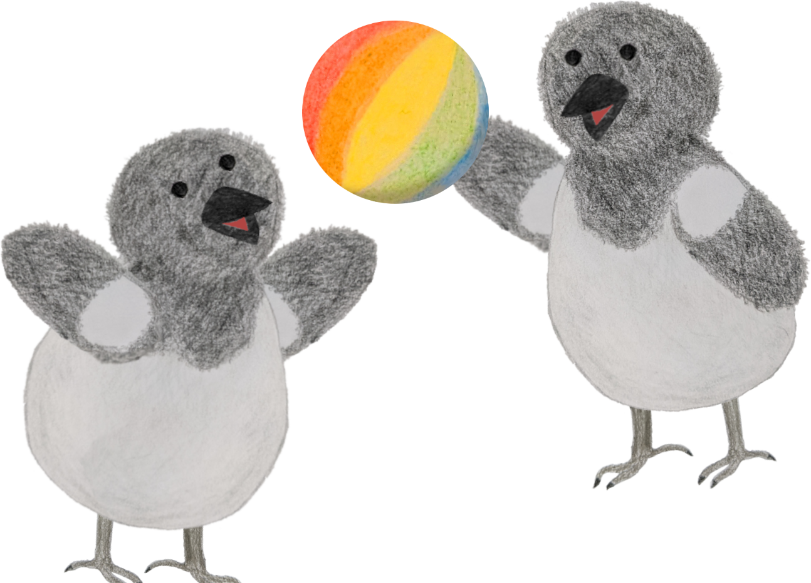
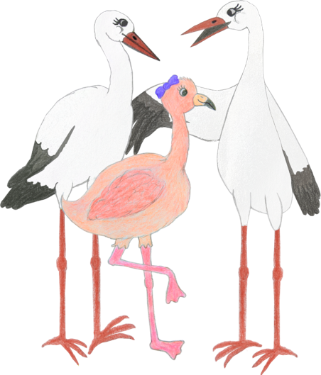
All families are different
Some families have one parent. Others have one Mummy and one Daddy, and some have two Mummies, or two Daddies.
Some have a step-Mum or a step-Dad, or both.
Some families have one child. Others have two, three, or even more.
Some families have step-brothers, step-sisters, half-brothers or half-sisters.
Notes:
Amend as appropriate for the child’s family and their level of understanding

Slide 5
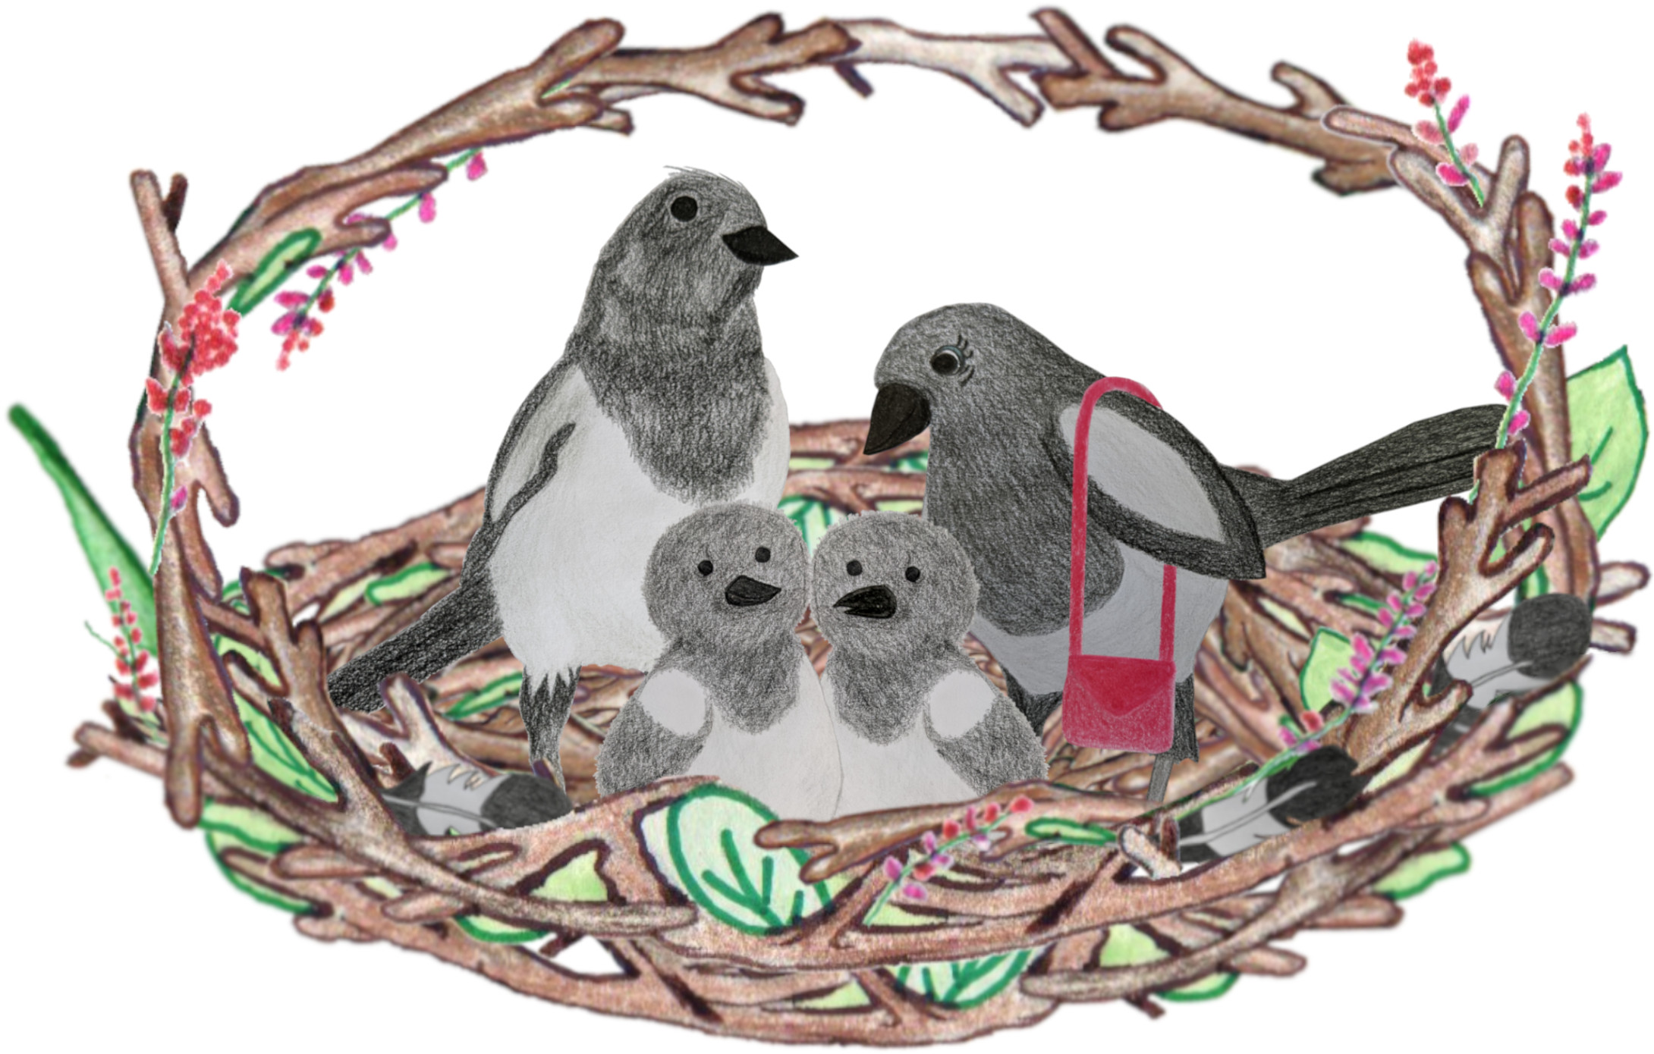
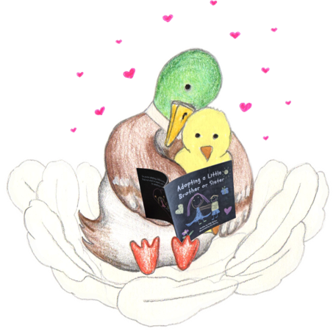
All families are different
Some children grow up with the family they are born into. Other children are adopted into a different family than the one they were born into.
Some children live with their grandparents, auntie, uncle, or someone else who loves them and looks after them.

Slide 6
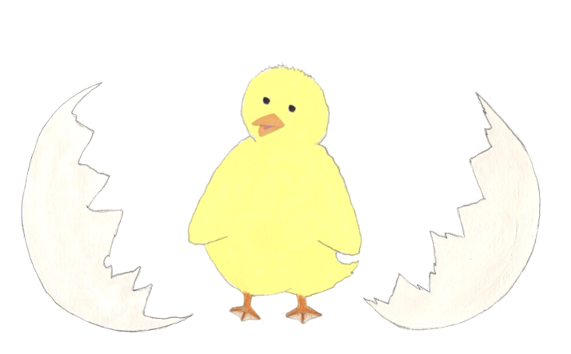
When you were younger
Insert any birth-related facts that are known. e.g.:
You were born on INSERT-DATE at the INSERT-NAME hospital.
You weighed xxx and were xx cm long.
You were born a week earlier than the doctors expected you to be born. You were very small, so had to stay in hospital for 2 weeks after you were born. You had lots of hair! Your birth father was there when you were born.
<In rare situations where no birth-related facts are known, you can write about when the child first became known to social services, and explain the birth date and name chosen, who chose it and any reason for the name chosen / meaning of the name.>
Insert photo of the child as a baby or young child if possible.
If no photo is available, you could insert a photo of the hospital.

Slide 7

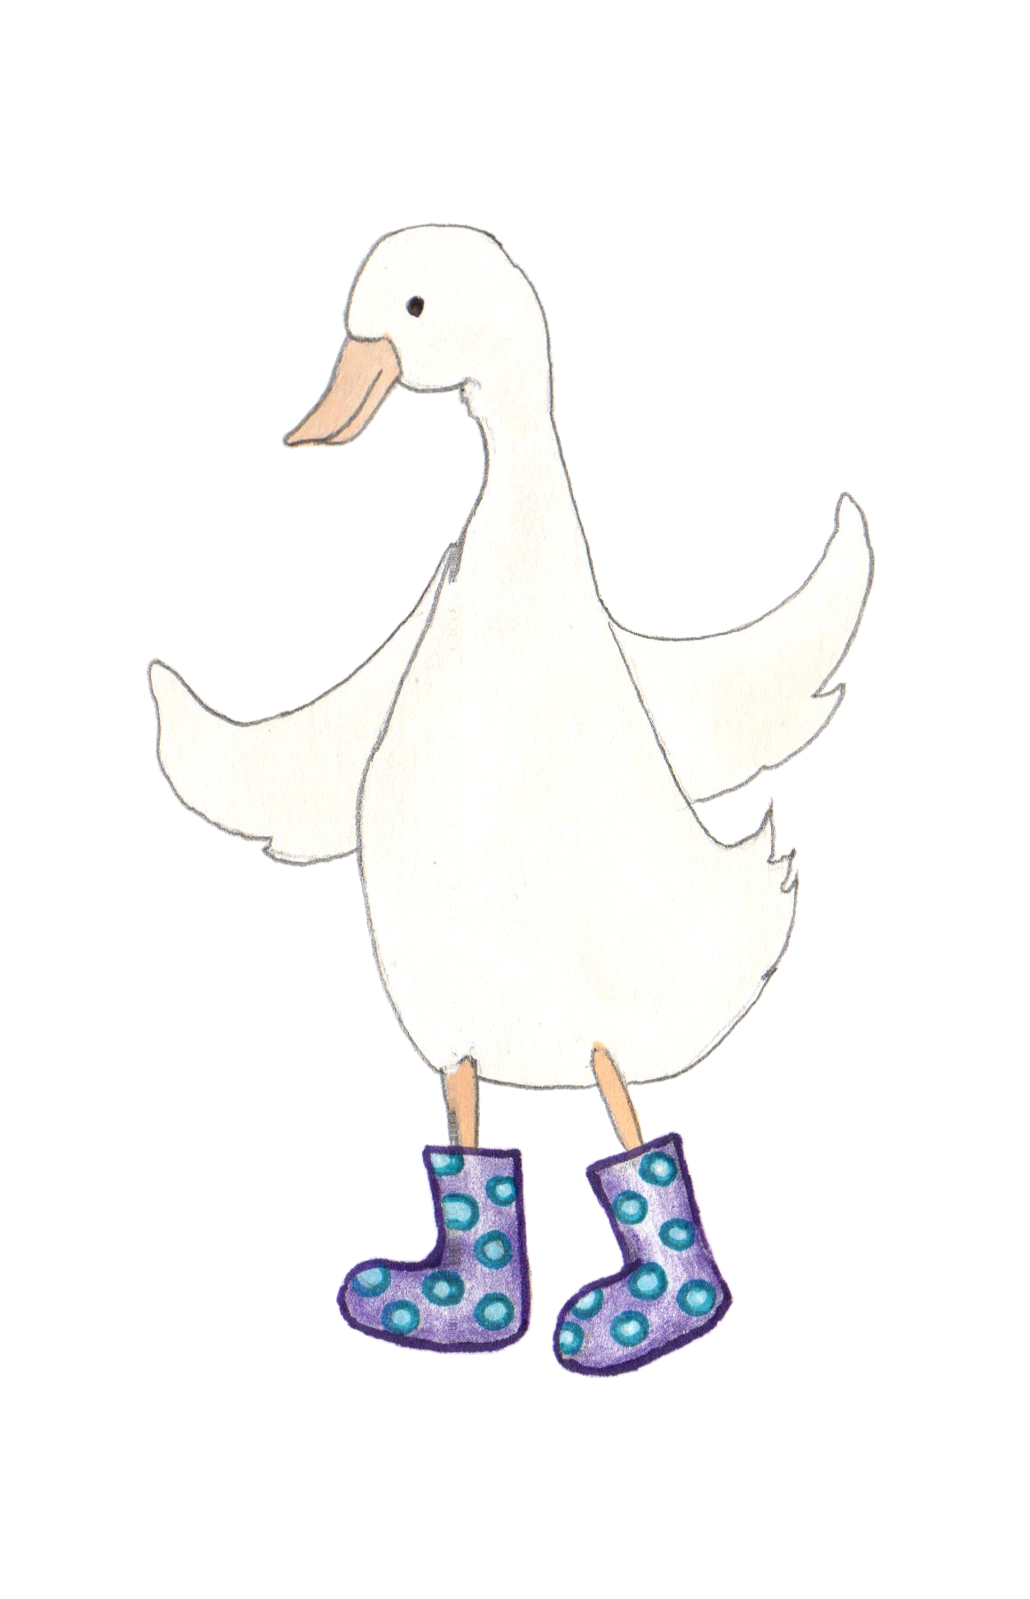
<Birth mother’s name>
You grew inside NAME’S tummy.
Alternative wording for older or more scientifically-minded children:
Babies grow inside a woman’s uterus. That’s a funny word for a place under a woman’s stomach where babies can grow. Some people call it a womb.
You grew inside NAME’S uterus.
Add any humanising facts known about her personality, e.g. hobbies and interests, favourite colour, favourite foods, children’s books she enjoyed reading as a child.
Insert photo
of birth mother (delete this placeholder if photo is not available)

Slide 8
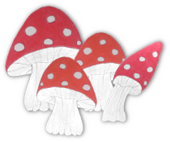
<Birth father’s name>
This is NAME. He was there when you were born / He was your Daddy when you were first born / He helped NAME to grow you in her tummy.
Alternative wording for older or more scientifically-minded children:
To grow a baby, a seed from a man joins an egg from a woman, then they grow in a woman’s uterus. The seed that made you came from a man called NAME.
Include any known humanising facts about the birth father. If the birth father only is unknown, delete this page, or explain with child-appropriate wording, e.g.:
The seed that made you came from a man, but we don’t know who that was. BIRTHMOTHER wouldn’t tell anyone / wasn’t sure who the seed came from.
Insert photo of birth father (delete this placeholder if photo is not available)
Notes:
Optional additional information:
“We don’t know if she told the man who gave her the seed that it grew into a baby.”
“BIRTHMOTHER said that…”<any child-appropriate information, e.g. if she mentioned that they met at a concert/that the child looked like their birth father when born, etc>
Caution - It can be tempting here to share facts like “You have brown eyes, although BIRTHMOTHER has blue eyes, so that tells us that the seed probably came from someone who had brown eyes.” If you do share information like this, beware that the child may then find themselves wondering if all brown-eyed men are that man. That said, a curious child may wonder if any stranger is their biological parent, and they will learn this sort of thing as they get older anyway! In this sort of situation, if true (e.g. if the child was adopted from a different area), you could add something like “we think he probably lives quite far away” to reassure the child that it’s probably not someone they’ll meet on a walk etc.

Slide 9
How babies grow
Alternative page for when biological parents are unknown
If both birth parents are unknown, delete the previous 3 pages. If either birth parent is known, delete this page.
Babies grow in a woman’s tummy, using a seed from a man. We don’t know whose tummy you grew in, or who the seed that helped make you came from.
Alt wording for older/scientifically minded children:
To grow a baby, a seed from a man joins an egg from a woman, then they grow in a woman’s uterus. That’s a funny word for a space under a woman’s stomach where babies can grow. Some people call it a womb.
We don’t know whose uterus you grew in, or who the seed that helped make you came from, but that must be what happened, because that’s how babies grow!

Slide 10
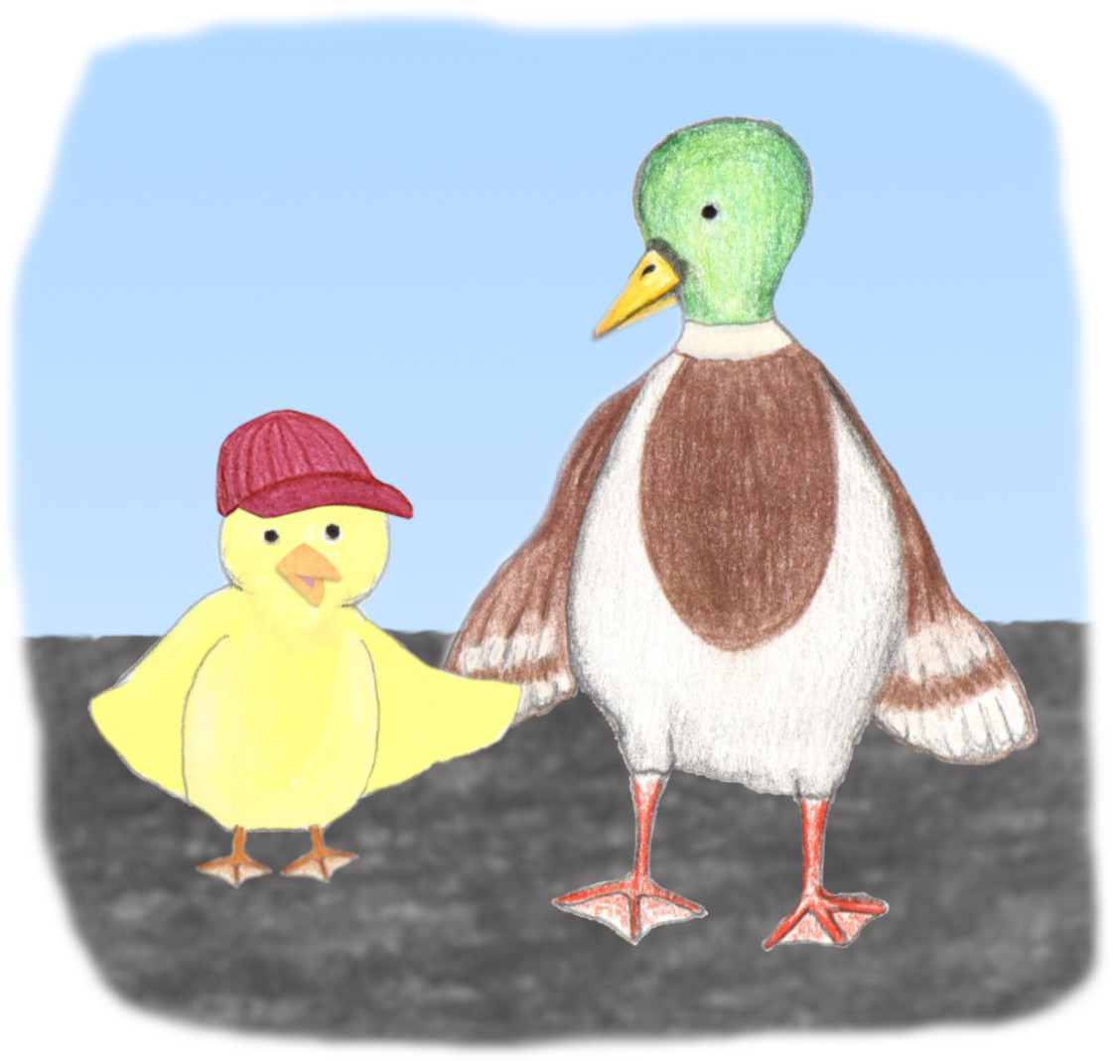
Children need to be safe
Grown-ups need to take care of children properly, to keep them safe. They need to:
Make sure their home is safe
Make sure children have clean bodies, clean clothes, brushed teeth and brushed hair
Remember to give the child lots of healthy food
Make sure children wear suncream or a hat when the sun might burn them
Make sure children have warm enough clothes, including coats when it is cold
Hold a child’s hand when they cross the road
Take children to the doctors, dentist and optician when they need to have a check-up
…and lots of other things! Parenting is busy!
Everybody makes mistakes sometimes, and it’s not a big problem if a parent sometimes forgets some of these things, but it isn’t OK if it happens a lot.
Notes:
When reading this page with a child, encourage them to think about what their parents do to keep them safe, healthy and happy. Remember that even adoptive parents will sometimes make mistakes, e.g. when they’re out, they may occasionally realise it’s cold and they should have packed a coat, etc, but it’s a pattern of concerns that leads to a child being removed from their birth family. You don’t want to cause the child to panic if their adoptive parent seems to be anything less than perfect! You can say things like “Your parents are really good at remembering to look after you properly, so they hardly ever forget to pack a coat or to bring snacks, but when you were a baby living with NAME, they kept forgetting the things you needed a LOT of the time, so you were cold and hungry and frightened. It wasn’t OK. You needed parents who would make sure they look after you properly” (based on the child’s actual situation, of course).

Slide 11
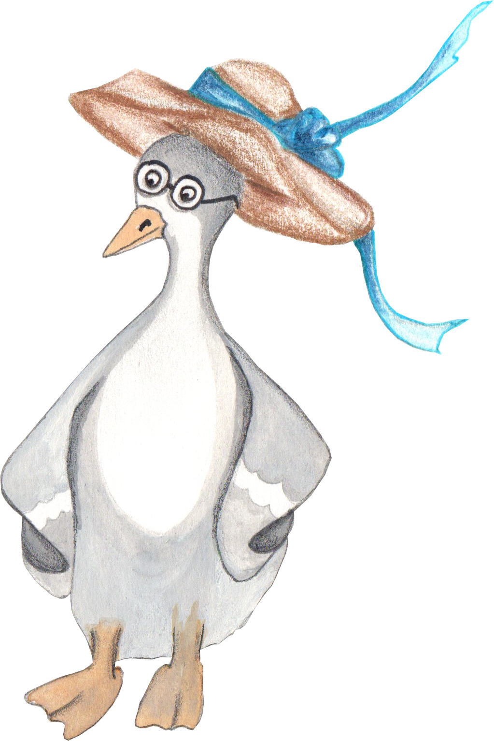
The Social Worker
Be specific about concerns here, in child-appropriate terms, e.g.:
Some people noticed that NAME and NAME weren’t looking after you properly and doing the things they needed to do to keep you safe, so they told a social worker.
Social workers are people who have had special training and they try to help people and families, to make sure everyone is safe.
A social worker tried to help NAME and NAME to make a safe home for you. She reminded them to keep you clean and warm, and that babies must not be left on their own.
NAME and NAME kept forgetting to feed you, so the social worker reminded them that babies need lots of milk, so that they can grow healthy and strong. They also kept forgetting to play with you, so the social worker reminded them that babies need to be given lots of attention so they feel loved and safe.
They left you on your own / argued a lot and sometimes hurt each other, which wasn’t safe and must have been scary for you.
When you were growing in X’s tummy/uterus, the doctors told her she should have lots of healthy food and not drink alcohol or smoke, or take drugs, but she kept doing those things, which could have made you very sick. You were OK, but she should have been taking better care of you.

Slide 12

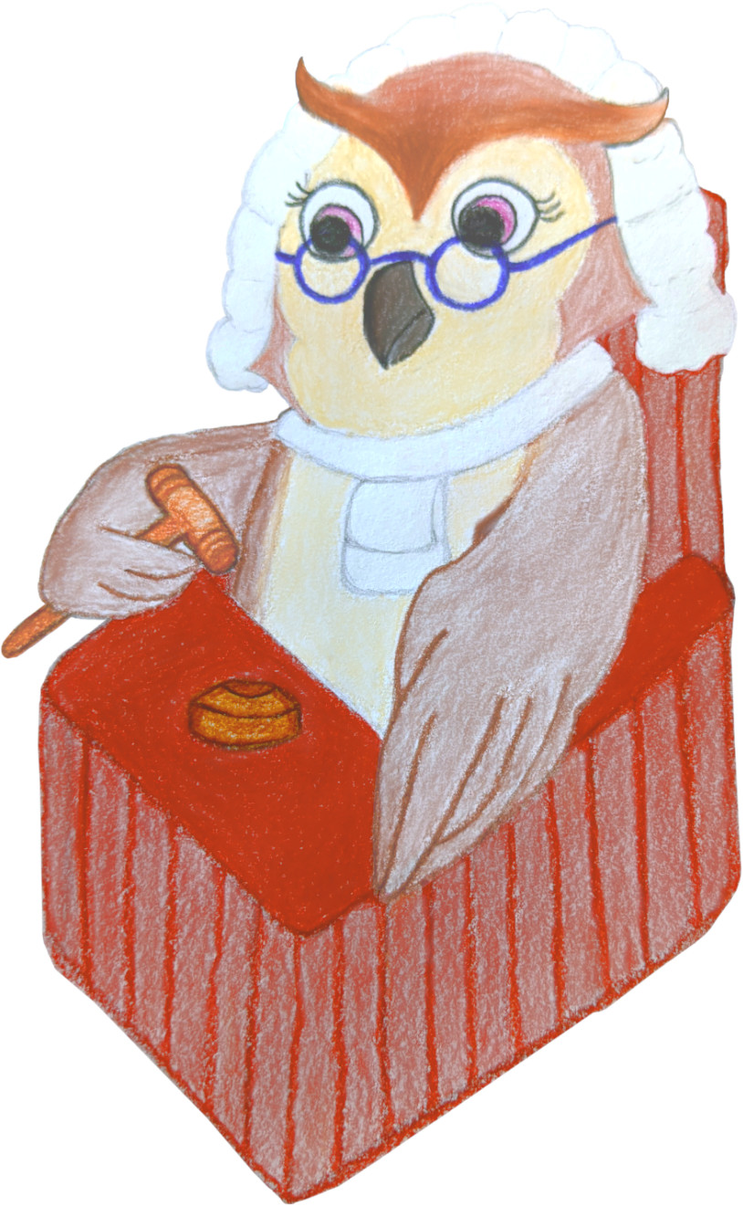
The Judge’s Decision
Even with the social worker’s help, NAME and NAME didn’t look after you properly. The social worker was worried about you, so they spoke to a wise judge, who knows a lot about keeping children safe. The judge listened carefully and thought about what would be best for you.
The judge decided that you should go to live with a different family, so that you would be safe, and looked after properly. She asked the social worker to find the right family for you.

Slide 13
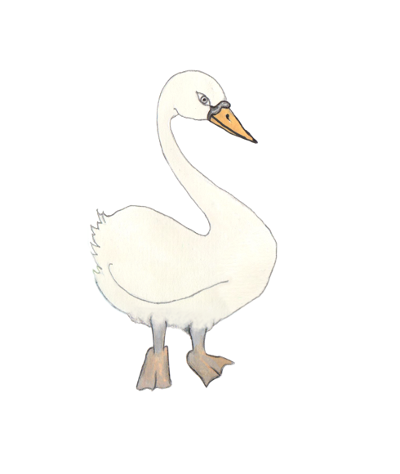
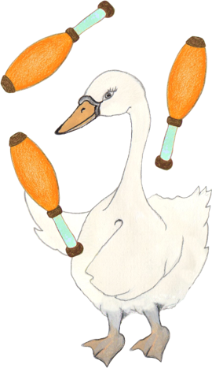
Your foster family
While the social worker was trying to find the right family for you to be part of, you stayed with a foster family.
Your foster family was NAME and NAME. It was NAME and NAME’s job to look after you and keep you safe.
They gave you healthy food and played games with you.
You grew a lot while you lived with NAME and NAME! You learned how to crawl and smile. They took you to play groups and swimming lessons.
Insert photo of the foster family

Slide 14
Your foster siblings
While you were in the foster family, some other children were there too. You played with NAME and NAME a lot. They were like brothers and sisters to you.
Insert photo of the foster family

Slide 15
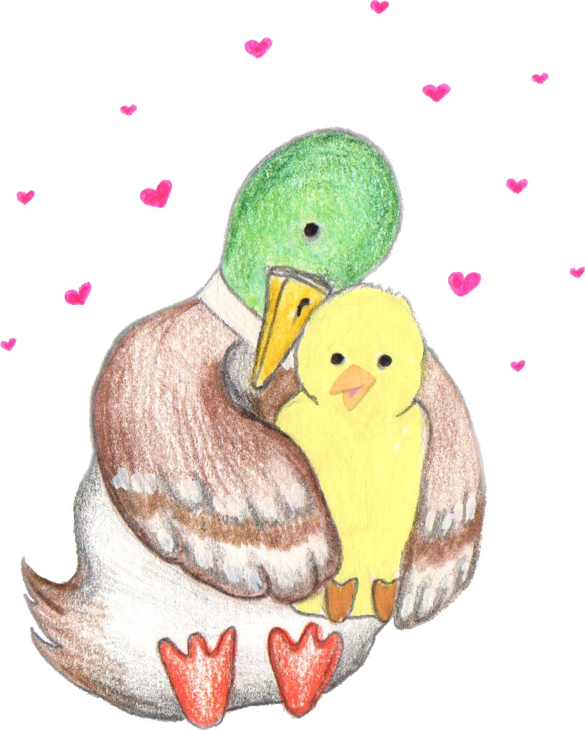
The right family
Your Mummy wanted to adopt a child, to love and look after.
The social worker asked your Mummy lots of questions. She decided that your Mummy would be the right family for you.
The judge agreed that you and your Mummy should be a family together.
You first met your Mummy when you were X years old. You spent a few weeks getting to know each other, then you moved to live with her. Your Mummy was very excited to be your family!

Slide 16

<Biological sibling’s name>
Share a bit about any biological siblings who have also been removed (delete whole slide if N/A). Some example wording for various scenarios:
Before you were born, BIRTHMOTHER and BIRTHFATHER had another child, called NAME. NAME is X years older than you. He lives with his grandparents and likes to play computer games.
X years after you were adopted, SIBLINGNAME grew in BIRTHMOTHER’s tummy. It was also not safe for SIBLINGNAME to stay living with BIRTHMOTHER, so she was adopted too and has a different family / lives with a foster family.
X years after you were adopted, BIRTHMOTHER had another child, called NAME. Some things have changed now, and BIRTHMOTHER has learned how to look after NAME properly. She has friends who will help her now, so the social worker and judge have decided that it is safe for NAME to stay in BIRTHMOTHER’s family.
Name is your biological sibling – that means you would have been in the same family if it had been safe for you both to stay with your birth parents.
Insert photo of birth sibling(s).
If there are lots of siblings, it may be appropriate to copy this page and give each sibling or sibling group their own page.

Slide 17
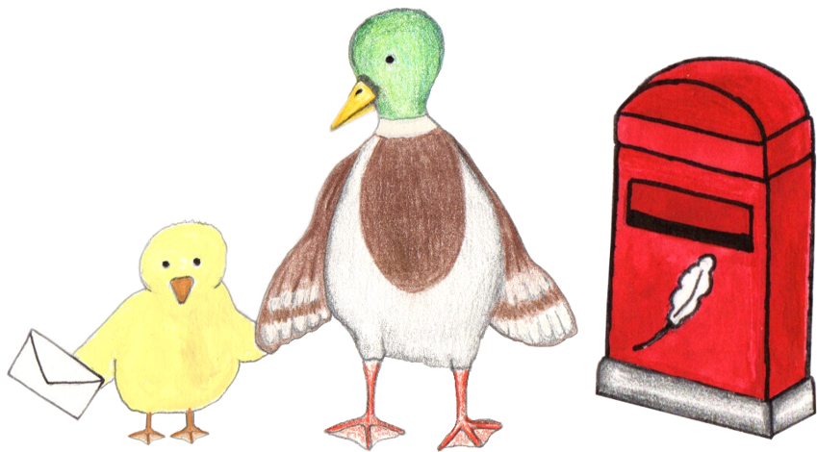
Keeping in touch
Your parents write letters sometimes to BIRTHPARENT and BIRTHPARENT, so that they know that you are safe, healthy, and happy.
If you like, you can make/choose some drawings or paintings to send to NAME and NAME with the letters next time, so they can see what you can do now.
If you ever have any questions about NAME or NAME, you can always talk to Mummy or Mama.

Slide 18
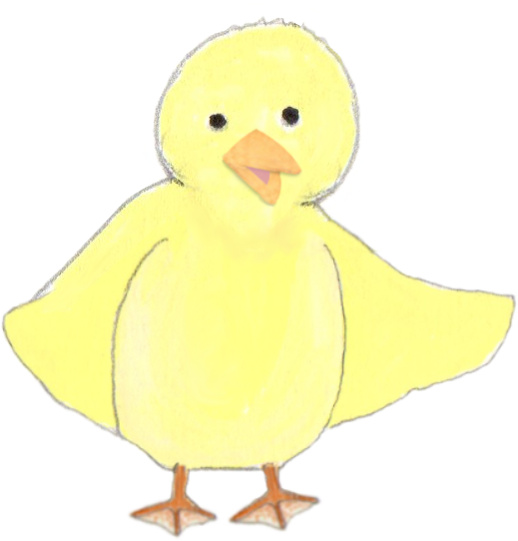
Growing up
Insert another family photo, or add more slides to share lots of photos of special memories!
You could also include a photo of the child holding up a small t-shirt from when they moved in, to show how much they’ve grown with their new family already.
Write here about what the child has learned/experienced since moving in, and then talk about the future, mentioning other family members. This is important, to reinforce that they will be in this family for the long term. E.g:
Every day, you grow a bit stronger and you learn new things. You have already learned lots of things since you came to live with Mummy and Daddy! You have learned how to draw, how to read and how to write.
You have lost a tooth and your hair has grown from your chin down to your shoulders! You are very creative and have brilliant ideas when you’re playing role play games.
You are growing so fast. It looks like you will be taller than Mummy by the time you’re a grown-up! Your Mummy and Daddy are so proud of you and are looking forward to seeing what amazing things you do in your life, with that clever brain and kind heart. Mummy thinks you might be a scientist, because you ask such clever questions!
Your parents have lots of fun adventures planned to share with you. Mummy is looking forward to teaching you to drive/cook and Daddy is looking forward to playing computer games with you / taking you fishing etc when you are older.
Notes:
When reading this page together, you can end by asking the child what they are looking forward to in their future. Talk about places they would like to visit, things they would like to try, etc. Keep inserting the family into the conversations about their future, e.g. if a child says they’d like to try rock climbing one day, you could reply “oh, I bet Mummy would love to try that with you!”

