Slide 1
CHILD’S NAME
Your family story
Insert photo of the child

Slide 2
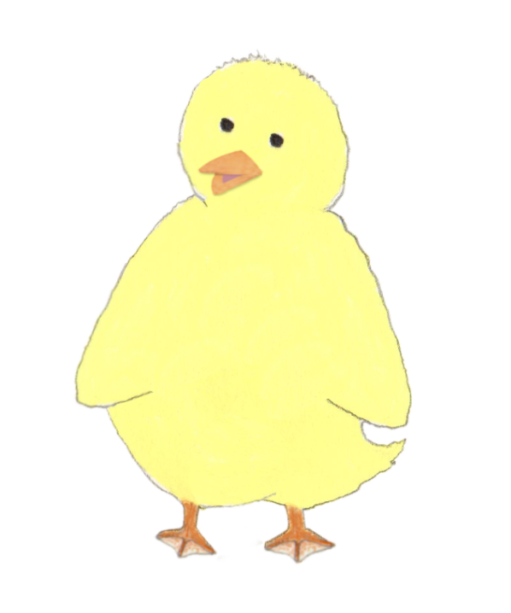
Wonderful You
Insert photo
of the child
Insert some text about the child’s personality, including lots of positives, for example:
You are a fun, busy child, with a lot of energy and a great sense of humour! You enjoy playing board games with your parents and going on picnics with your grandparents. Your favourite foods are xyz and you are a brilliant dancer! You are kind and you like to help Mummy plant things in the garden.

Slide 3
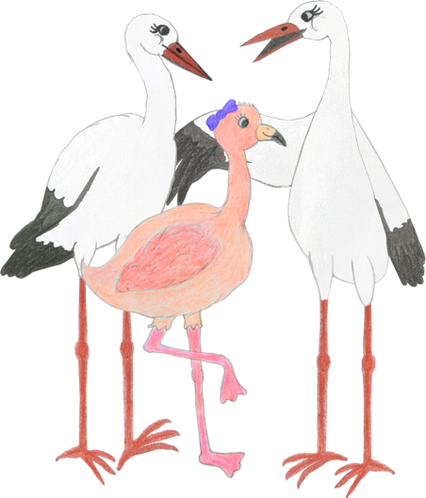
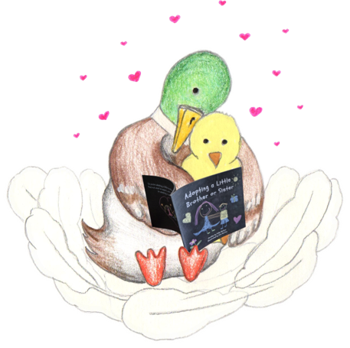
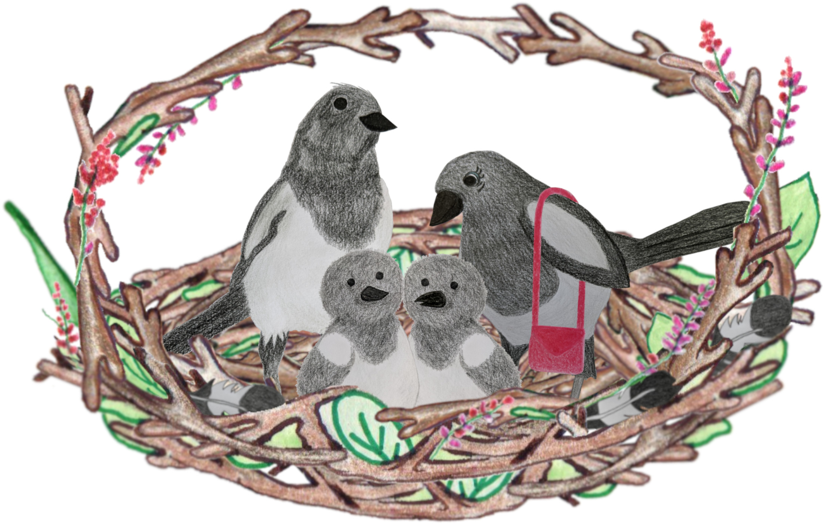
Everyone’s family is different
Some families have one parent. Some have two Mummies, or two Daddies. Some have a step-Mum or a step-Dad, or both!
Some families have lots of siblings, and some have none. Some families have step-brothers, step-sisters, half-brothers or half-sisters.
Some children live with their grandparents, auntie, uncle, or someone else who loves them and looks after them.
Notes:
Amend as appropriate for your family and the child’s understanding.
If you are a parent writing this and you are divorced/separated and your child spends time with both of you in different homes, you can add that in some families, the children stay with one parent for most of the time, and stay with the other parent at weekends, etc, to normalise your own situation.

Slide 4
Your family
Your family is Mummy, Daddy, and you!
You also have grandparents, aunties, uncles and cousins.
Everyone in your family loves you very much and feels very lucky to have you in their life.
This book talks about why and how you joined your family.
Insert family photo
Notes:
Edit/delete/add text as applicable to the child’s family. List all immediate family members in the adoptive family. Pets can be included too!

Slide 5
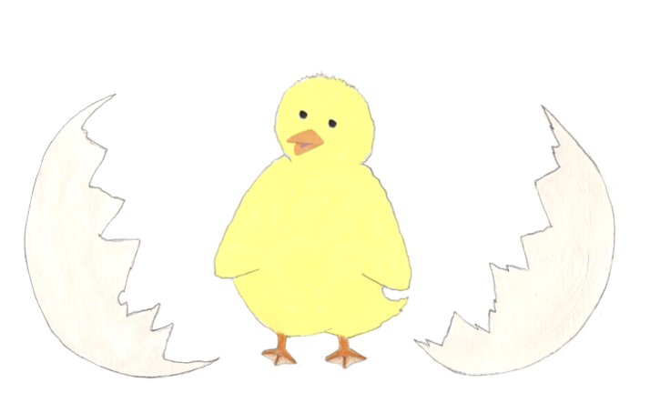
When you were born
You were born on INSERTDATE at the SUCHANDSUCH hospital.
You weighed xxx and were xx cm long.
<insert any other birth-related facts that are known, e.g. you were born a week earlier than the doctors expected you to be born / you were very small, so had to stay in hospital for 2 weeks after you were born / you had lots of hair, etc.>
Insert photo of the child at birth, if you have one.
Alternatively, you could insert a photo of the hospital from their website.

Slide 6
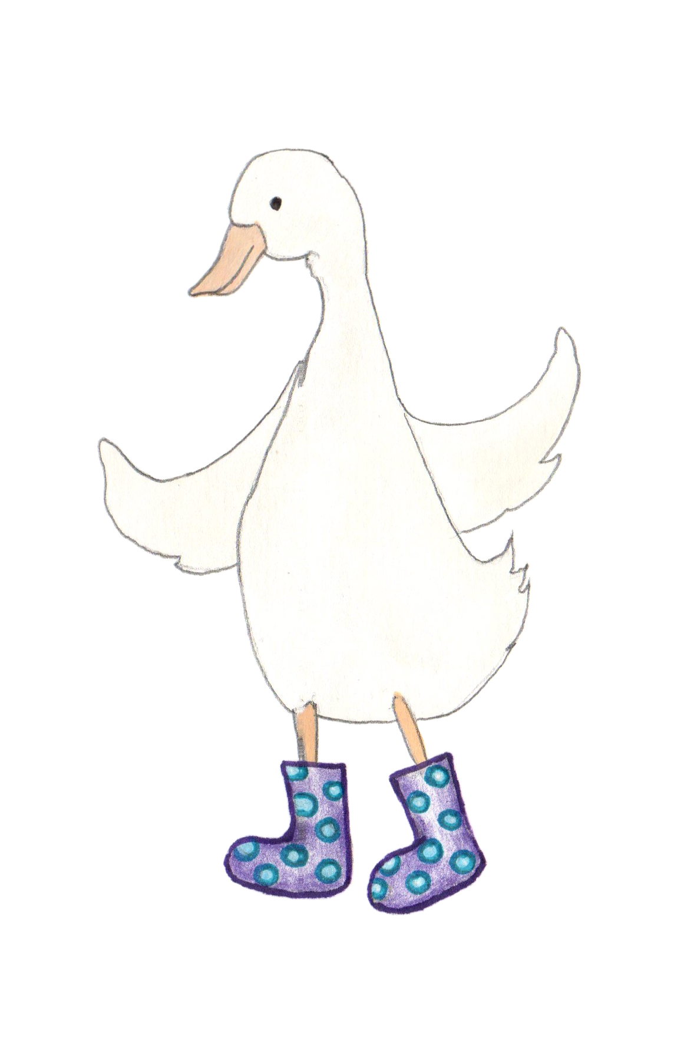
<Birth mother’s name>
You grew inside NAME’S tummy.
Include any facts you know or can find out about her personality, e.g. hobbies, favourite colour, food, children’s books she enjoyed reading as a child.
Insert photo
of birth mother
Notes:
Alternative wording for older or more scientifically-minded children:
Babies grow inside a woman’s uterus. That’s a funny word for a place under a woman’s stomach where babies can grow. Some people call it a womb.
You grew inside NAME’S uterus.

Slide 7
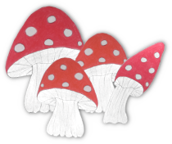
<Birth father’s name>
This is NAME. He was your there when you were born / He was your Daddy when you were first born / He helped NAME to grow you in her tummy.
Delete as appropriate for age & understanding. Alternative wording for older or more scientifically-minded children: To grow a baby, a seed from a man joins an egg from a woman, then they grow in a woman’s uterus. The seed that made you came from a man called NAME.
Include any known personal facts about the birth father.
If the birth father is unknown, you can delete this page, or explain with child-appropriate wording, such as: The seed that made you came from a man, but we don’t know who that was.
Insert photo of birth father

Slide 8
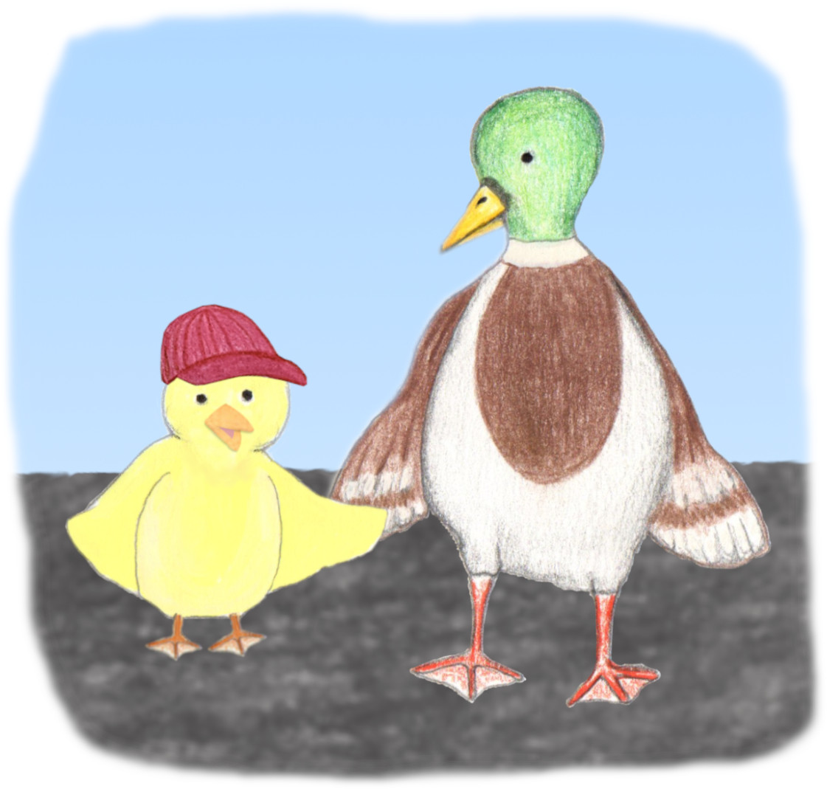
Children need to be safe
Grown-ups need to take care of children properly, to keep them safe. They need to:
Make sure their home is safe
Make sure they have clothes and toys
Remember to give the child lots of healthy food
Make sure children wear suncream or a hat when the sun might burn them
Make sure children have warm enough clothes, including coats when it is cold
Hold a child’s hand when they cross the road
Take children to the doctors, dentist and optician when they need to have a check-up
…and lots of other things! Parenting is busy!

Slide 9
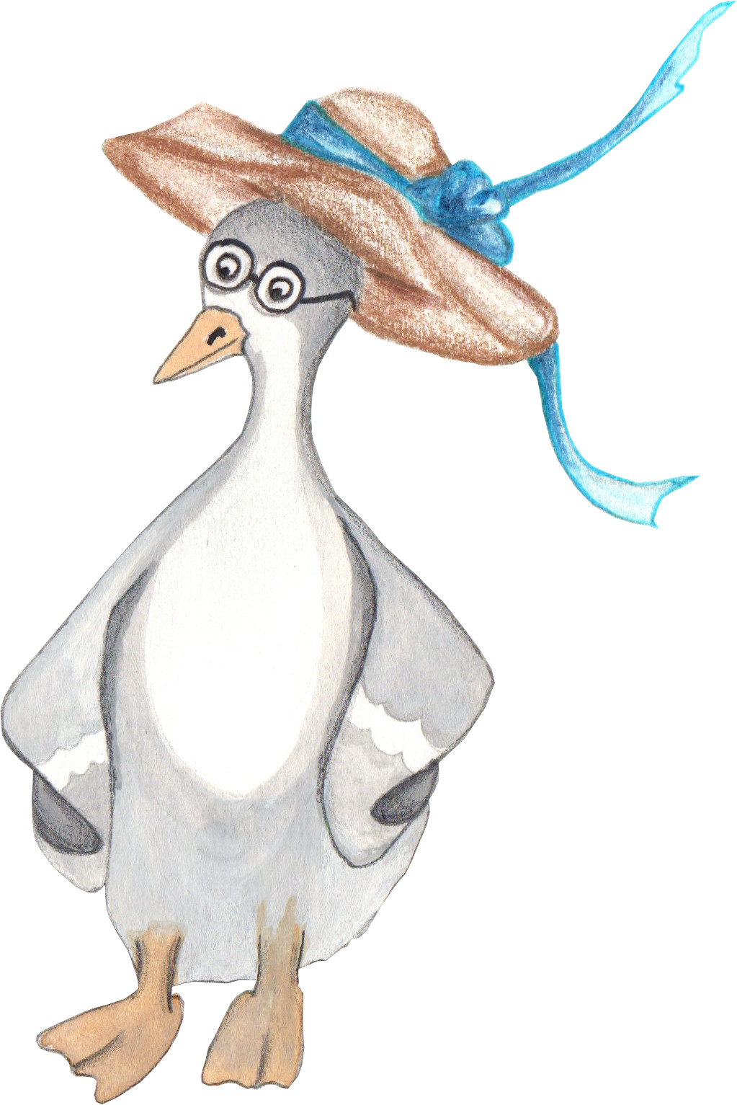
The Social Worker
Some people noticed that NAME and NAME weren’t looking after you properly and doing the things they needed to do to keep you safe.
Social workers are people who have had special training and they try to help people and families, to make sure everyone is safe.
Be more specific about concerns here, in child-appropriate terms, such as:
A social worker tried to help NAME and NAME to make a safe home for you. She reminded them to feed you milk, and that babies must not be left on their own.
NAME kept forgetting to feed you, so the social worker reminded her that babies need lots of milk so that they can grow healthy and strong.

Slide 10
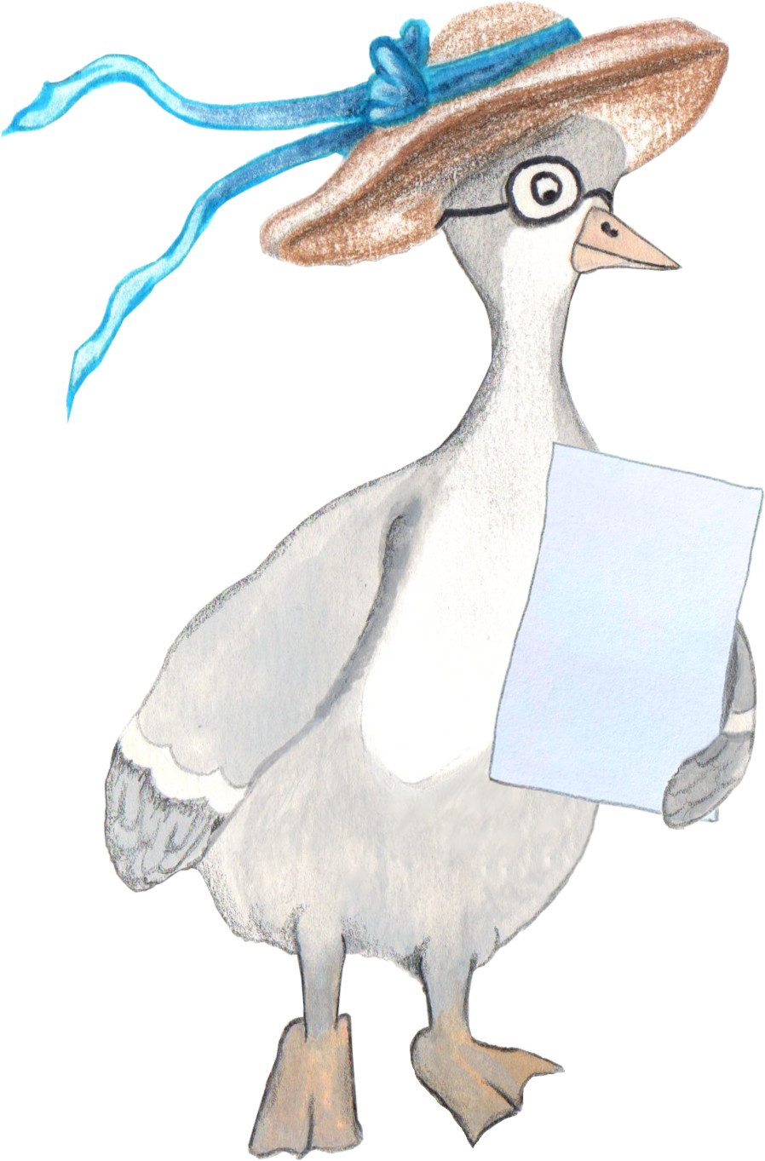
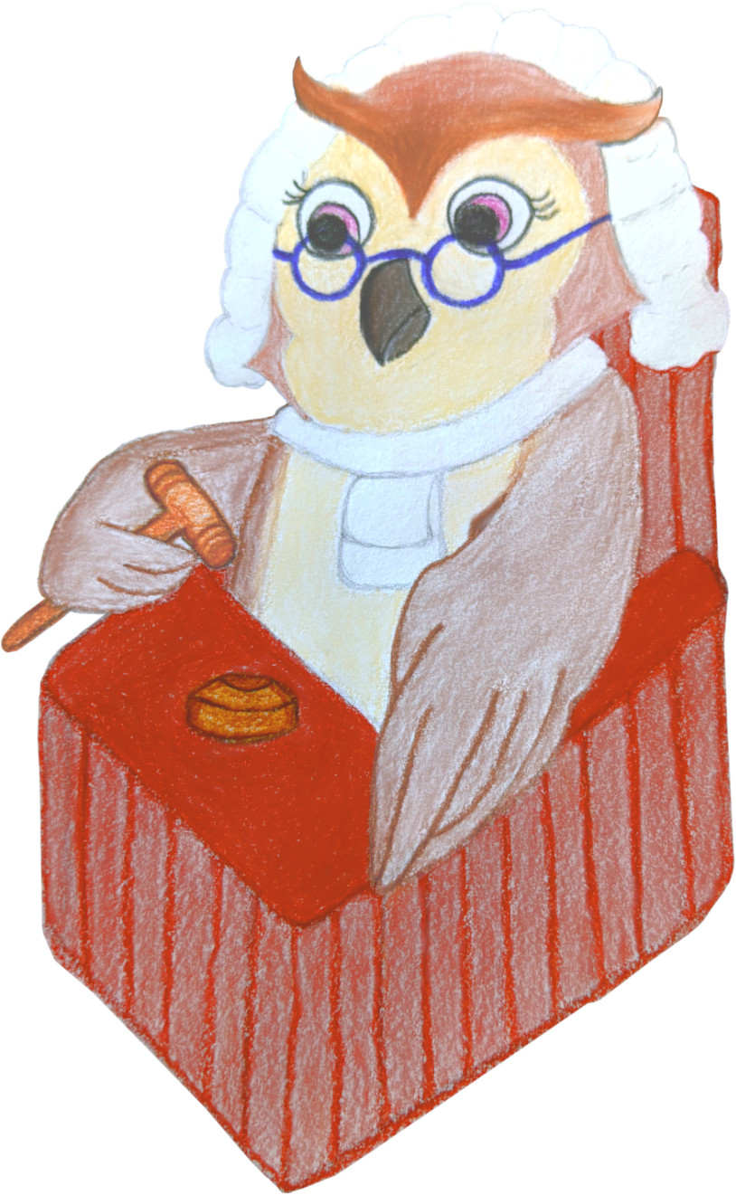
The Judge’s Decision
Even with help from the social worker, NAME and NAME didn’t look after you properly.
The social worker spoke to a wise judge, who knows a lot about keeping children safe. The judge listened carefully and thought about what would be best for you.
The judge decided that you should go to live with a different family, so that you would be safe, and looked after properly. She asked the social worker to find the right family for you.

Slide 11
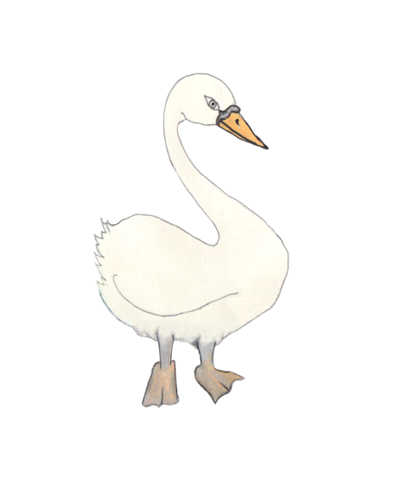
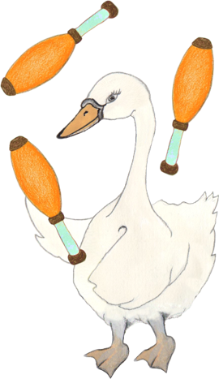
Your foster family
While the social worker was trying to find the right family for you, you stayed with a foster family.
Your foster family was NAME and NAME. It was NAME and NAME’s job to look after you and keep you safe.
They gave you healthy food and played games with you.
You grew a lot while you lived with NAME and NAME! You learned how to crawl and smile. They took you to play groups and swimming lessons.
Insert photo of the foster family

Slide 12
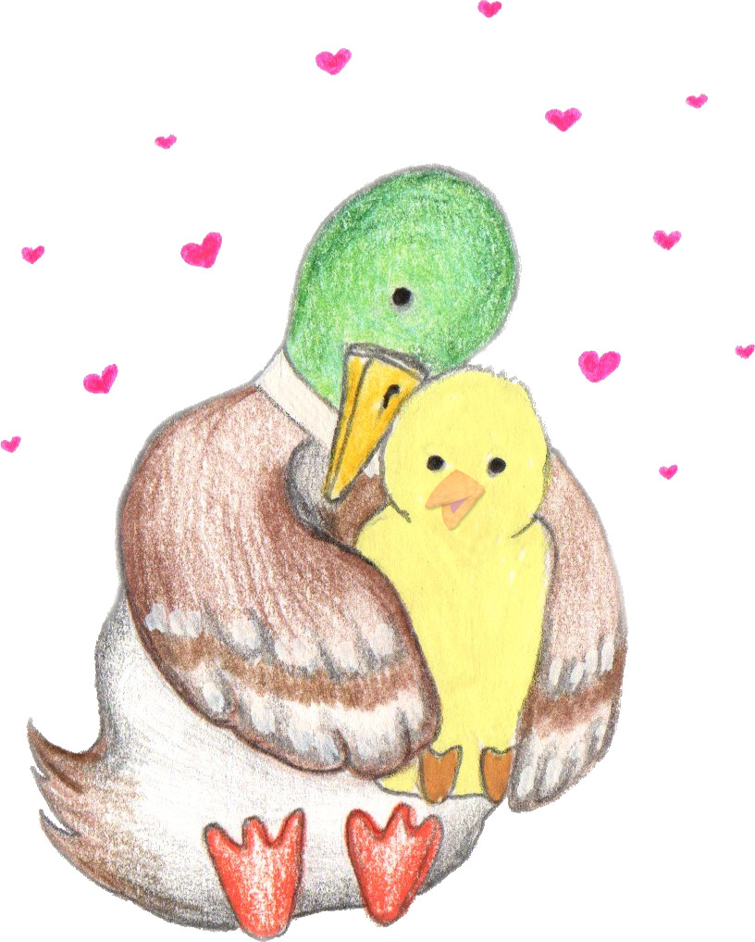
The right family
Your Mummy wanted to adopt a child, to love and look after.
The social worker asked your Mummy lots of questions. She decided that your Mummy would be the right family for you.
The judge agreed that you and your Mummy should be a family together.
You first met your Mummy when you were X years old. You spent a few weeks getting to know each other, then you moved to live with her. Your Mummy was very excited to be your family!

Slide 13
<Birth sibling’s name>
Share a bit about any biological siblings who have also been removed (delete if N/A). Some example wording for various scenarios:
Before you were born, BIRTHMOTHER and BIRTHFATHER had another child, called NAME. NAME is X years older than you. He lives with his grandparents / was adopted too and has a different family.
BIRTHMOTHER has had another child, called NAME. NAME is X years younger than you. She lives with her grandparents / was adopted too and has a different family.
BIRTHMOTHER has had another child, called NAME. Some things have changed now, and BIRTHMOTHER has learned how to look after NAME properly. She has friends who will help her now, so the social worker and judge have decided that it is safe for NAME to stay in BIRTHMOTHER’s family.
Insert photo of birth sibling(s).
If there are lots of siblings, it may be appropriate to copy this page and give each sibling or sibling group their own page.

Slide 14
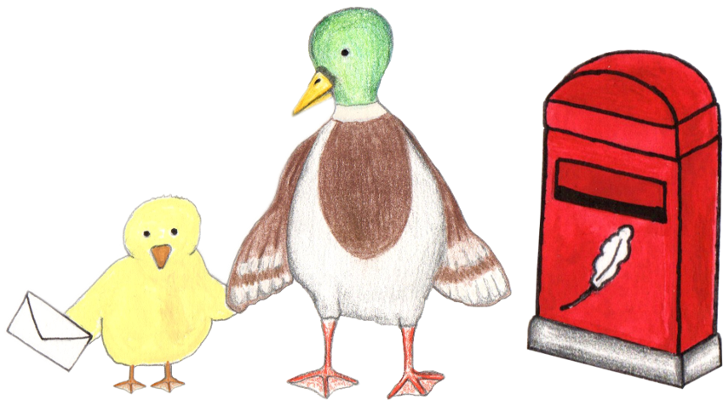
Keeping in touch
Your parents write letters sometimes to BIRTHPARENT and BIRTHPARENT, so that they know that you are safe, healthy, and happy.
If you like, you can make/choose some drawings or paintings to send to NAME and NAME with the letters next time, so they can see what you can do now.
If you ever have any questions about NAME or NAME, you can always talk to Mummy or Mama.

Slide 15
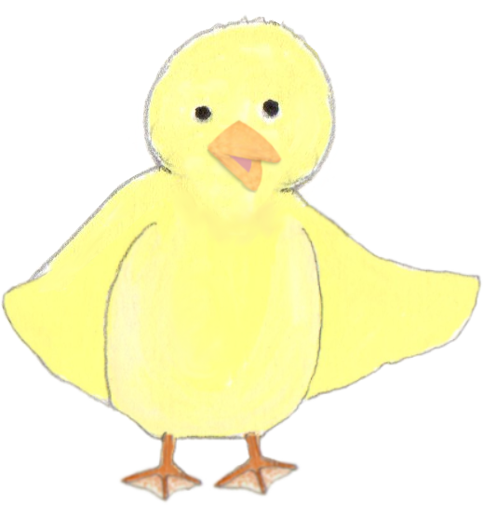
Growing up
Insert another family photo, or add more slides to share lots of photos of special memories!
You could also include a photo of the child holding up a small t-shirt from when they moved in, to show how much they’ve grown with their new family already.
Write here about what the child has learned/experienced since moving in, and then talk about the future, mentioning other family members. This is important, to reinforce that they will be in this family for the long term. E.g:
Every day, you grow a bit stronger and you learn new things. You have already learned lots of things since you came to live with Mummy and Daddy! You have learned how to draw, how to read and how to write. You have lost a tooth and your hair has grown from your chin down to your shoulders! You are very creative and have brilliant ideas when you’re playing role play games.
You are growing so fast. It looks like you will be taller than Mummy by the time you’re a grown-up! Your Mummy and Daddy are so proud of you and are looking forward to seeing what amazing things you do in your life, with that clever brain and kind heart. Mummy thinks you might be a scientist, because you ask such clever questions! Your parents have lots of fun adventures planned to share with you. Mummy is looking forward to teaching you to drive/cook and Daddy is looking forward to playing computer games with you / taking you fishing etc when you are older.
Notes:
When reading this page together, you can end by asking the child what they are looking forward to in their future. Talk about places they would like to visit, things they would like to try, etc. Keep inserting the family into the conversations about their future, e.g. if a child says they’d like to try rock climbing one day, you can reply “oh, I bet Mummy would love to try that with you!”

